Slide 1
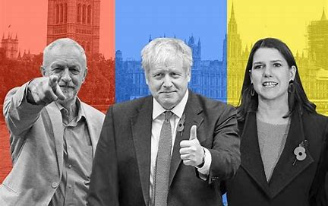
2019 General Election - manifestos

Slide 2
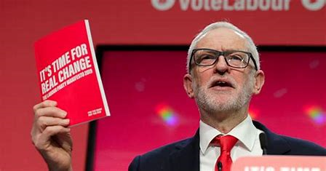
The Labour Party
https://www.bbc.co.uk/news/election-2019-50497288

Slide 3
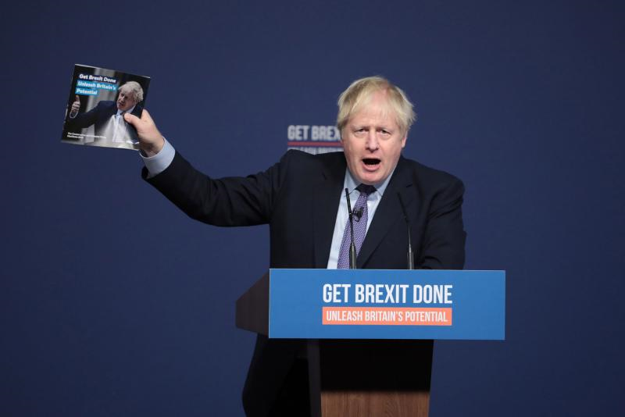
The Conservatives
https://www.bbc.co.uk/news/election-2019-50532000

Slide 4
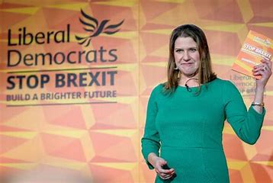
Liberal Democrats
https://www.bbc.co.uk/news/election-2019-50459123

Slide 5
Tasks 1-3
Economic
Welfare
Law and Order
Foreign Affairs
Brexit

Slide 6
Task 4
Write a paragraph on each party on whether their policies were left or right wing

